Slide 1

BATCH IN 2019

Slide 2
Safe Harbor Statement
The following is intended to outline the general direction of Pivotal's offerings. It is intended for
information purposes only and may not be incorporated into any contract. Any information
regarding pre-release of Pivotal offerings, future updates or other planned modifications is
subject to ongoing evaluation by Pivotal and is subject to change. This information is provided
without warranty or any kind, express or implied, and is not a commitment to deliver any
material, code, or functionality, and should not be relied upon in making purchasing decisions
regarding Pivotal's offerings. These purchasing decisions should only be based on features
currently available. The development, release, and timing of any features or functionality
described for Pivotal's offerings in this presentation remain at the sole discretion of Pivotal.
Pivotal has no obligation to update forward looking information in this presentation.

Slide 3

2019!

Slide 4

ANY REPLICANTS?

Slide 5


HOVERBOARDS OR FLYING CARS?

Slide 6
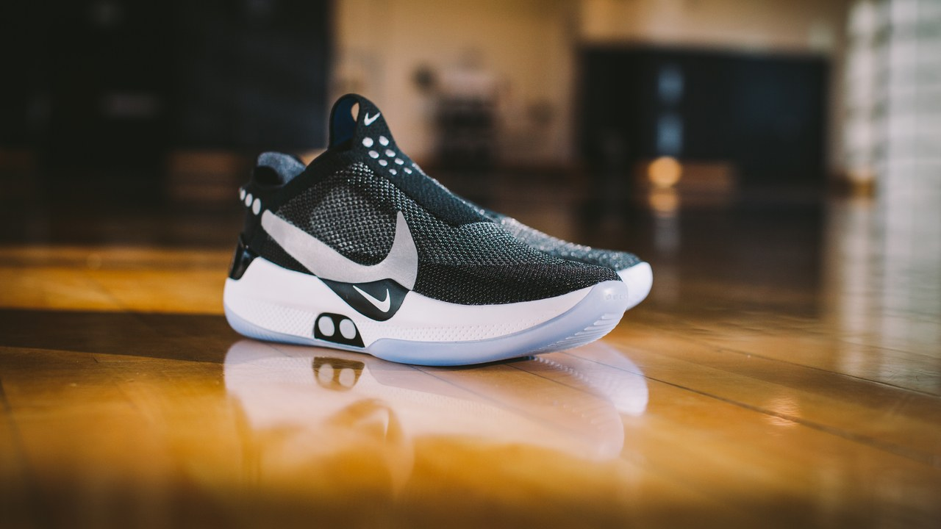
SELF LACING SHOES!

Slide 7
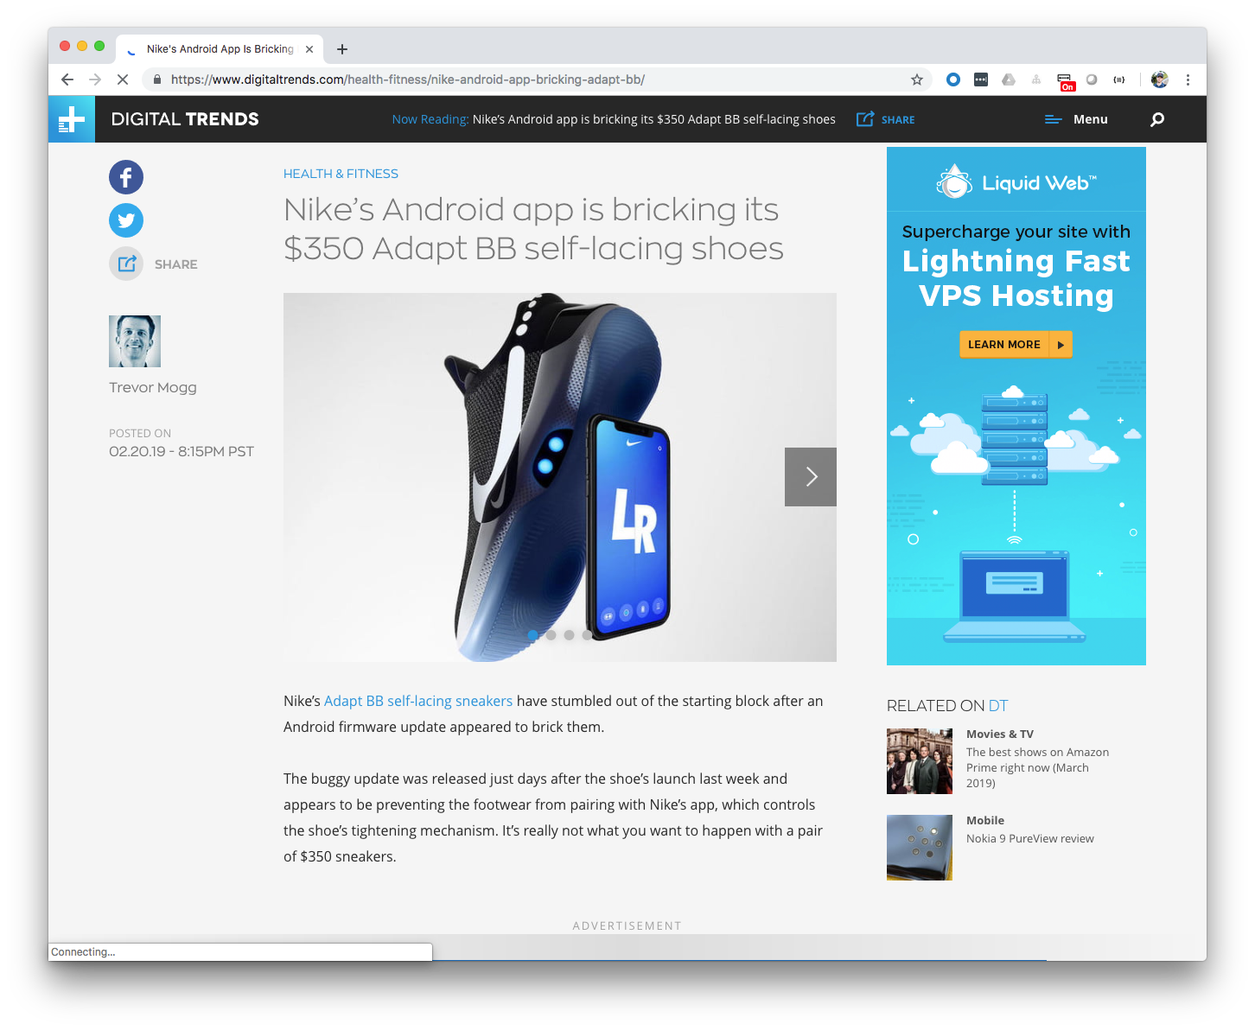

Slide 8

ALL THESE AMAZING THINGS
THE FUTURE HAS BROUGHT US…

Slide 9


Slide 10
고맙습니다!
شكرا لك.
Hvala vam!
Merci!
¡Gracias!
Dziękuję!
Благодарю!
धन्यवाद।
THANK YOU!
Danke!
Děkuju!
Grazie!
Sağol!
Obrigado!
Благодаря!
谢谢!

Slide 11


MICHAEL MINELLA
Lead | Spring Batch & Spring Cloud Task
JSR-352 | Expert Group Member and Committer
Author | Pro Spring Batch and The D G to Spring Batch
Speaker | JavaOne Rockstar and Java Champion
Podcast | OffHeap Curmudgeon

Slide 12
@michaelminella
@OffHeap

Slide 13
AVAILABLE
NOW!
https://www.apress.com/us/book/9781484237236

Slide 14

http://www.javaoffheap.com/

Slide 15
MAHMOUD BEN HASSINE
Committer Spring Batch
Founder http://jeasy.org
Blogger https://benas.github.io
Github @benas

Slide 16
@b_e_n_a_s

Slide 17

SLIDES AND CODE
ARE ON GITHUB
https://github.com/mminella/Batch-In-2019
Notes:
S1P 2018 branch was used in the presentation at Spring One Platform 2018

Slide 18

Notes:
Please ask questions when you have them

Slide 19


LAY OF THE LAND

Slide 20

SPRING FRAMEWORK

Slide 21
SPRING BATCH

Slide 22

SPRING CLOUD DATA FLOW

Slide 23

MICROMETER

Slide 24

PROMETHEUS

Slide 25

GRAFANA

Slide 26
¯\_(ツ)_/¯

Slide 27

SPRING BATCH 101

Slide 28

DAY IN THE LIFE OF
A BATCH DEVELOPER

Slide 29

GET OUR COFFEE

Slide 30

CHECK THE STATUS
OF THE EXISTING JOBS

Slide 31

ADD A NEW FEATURE

Slide 32

GO TO
PRODUCTION!

Slide 33

SPRING BATCH 101

Slide 34
Batch processing, … is defined as the processing of a finite amount of data without interaction or interruption
-- Michael Minella
The Definitive Guide to Spring Batch

Slide 35

LINGO

Slide 36

JOB

Slide 37
STEP

Slide 38


TASKLET VS CHUNK

Slide 39

ITEM

Slide 40
CHUNK

Slide 41
FLOW OF STEPS/COMPONENTS
STEP1
STEP2
STEP3
ItemReader
ItemReader
ItemReader
ItemProcessor
ItemProcessor
ItemProcessor
ItemWriter
ItemWriter
ItemWriter

Slide 42


Slide 43
ARCHITECTURE
ItemReader
JobLauncher
Job
Step
ItemProcessor
ItemWriter
JobRepository

Slide 44

CHECK THE STATUS
OF THE EXISTING JOBS

Slide 45



Spring Batch/Spring Cloud Task
RSocket Proxy
Prometheus
Grafana
Spring Cloud Data Flow

Slide 46

ADD A NEW FEATURE

Slide 47
Step1
Step2
ItemReader
Tasklet
ItemWriter

Slide 48

GO TO
PRODUCTION!

Slide 49
Github
CircleCI
Spring Cloud Data Flow
Maven Repository

Slide 50
Github
CircleCI
Spring Cloud Data Flow
jitpack.io

Slide 51

LOOKING AHEAD

Slide 52
SPRING BATCH 4.2.0.RELEASE

Slide 53

NEW FEATURES

Slide 54
METRICS VIA
MICROMETER

Slide 55

READING & WRITING TO
APACHE KAFKA

Slide 56

READING & WRITING TO
APACHE AVRO

Slide 57

PERFORMANCE

Slide 58
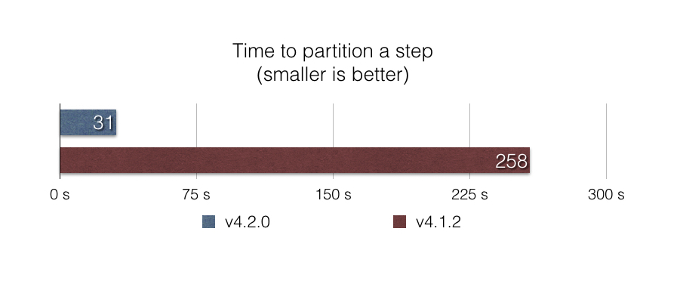
ENHANCED STEP PARTITIONING
https://github.com/benas/spring-batch-sandbox/tree/master/batch2716

Slide 59
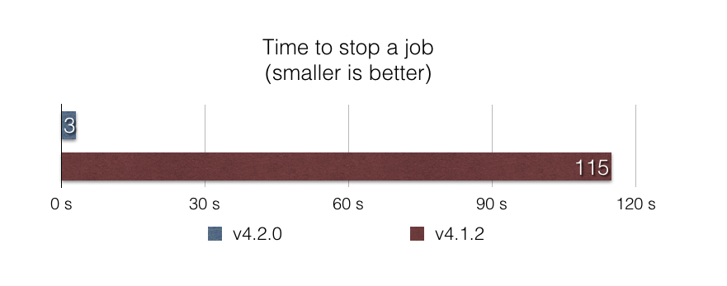
IMPROVED JOB STOP
https://github.com/benas/spring-batch-sandbox/tree/master/batch2442

Slide 60
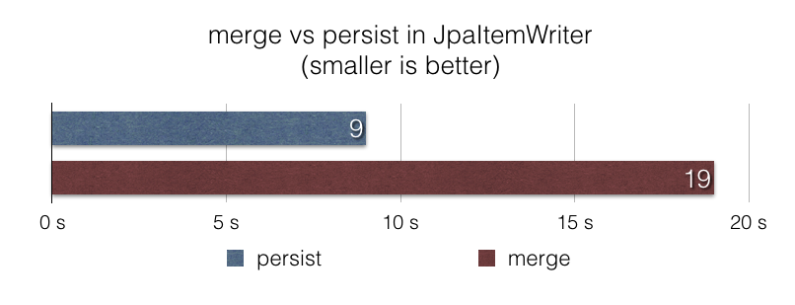
JpaItemWriter ENHANCEMENTS
https://github.com/benas/spring-batch-sandbox/tree/master/batch2462

Slide 61

MASTER AND SLAVE

Slide 62
SPRING CLOUD
DATA FLOW 2.3!

Slide 63
SPRING CLOUD
DATA FLOW 2.3.M2

Slide 64

CONTINUOUS DEPLOYMENT
FOR TASKS

Slide 65
TASK METRICS
VIA MICROMETER

Slide 66

IMPORT/EXPORT
COMMANDS

Slide 67
Notes:
Please ask questions when you have them

